Slide 1

E-COMMERCE SALES PREDICTION MACHINE LEARNING – 18CSC383 Ms. PRAJNA DORA
AASHIKA B S - CB.SC.I5DAS19003
DHANUSHRI M - CB.SC.I5DAS19015
KEERTHANA PRIYA D - CB.SC.I5DAS19018
SHIVADA K P - CB.SC.I5DAS19028

Slide 2

DESCRIPTION
Ecommerce is a platform where people buy and sell products conveniently from anyplace or anytime.
So, in order to make this experience even better and to improve the profit of the company machine learning approach is taken.
E-commerce sales prediction project focuses on predicting the profit

Slide 3

MOTIVATION
People don’t just shop from home; they are making purchases anywhere they have wifi or phone service.
Sixty-two percent of smartphone users have made a purchase online using their mobile device in the last six months.
Selling via online increases reach of products.

Slide 4

By incorporating machine learning in e-commerce sector, meaningful insights can be drawn by the business stakeholders and they can make necessary changes to improve their business.
Determine incremental impacts of new initiatives
Reduced spoilage and fresher, more appealing products through more accurate stock allocation,
Project future budgets

Slide 5

CHALLENGES
Dataset of the e-commerce is too vast to analyze and draw insights from it.
Startup cannot predict the profit and due to lack of knowledge.
Without proper sales forecasting, many business decisions are based on unreliable estimates or instinct – which leads to many inefficiencies and missed opportunities.

Slide 6

DESCRIPTION OF DATASET
This project uses a dataset from an e-commerce website.
It contains 4117 orders from 2011 to 2014 made at multiple marketplaces in the world.
Its features allows viewing an order from multiple dimensions

Slide 7
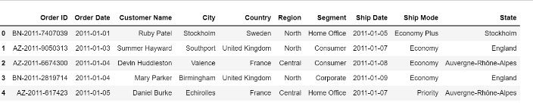
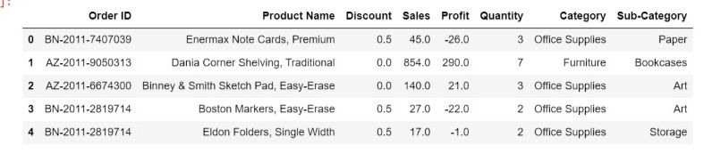
The Dataset before merging:
ListOfOrders
OrderBreakdown

Slide 8
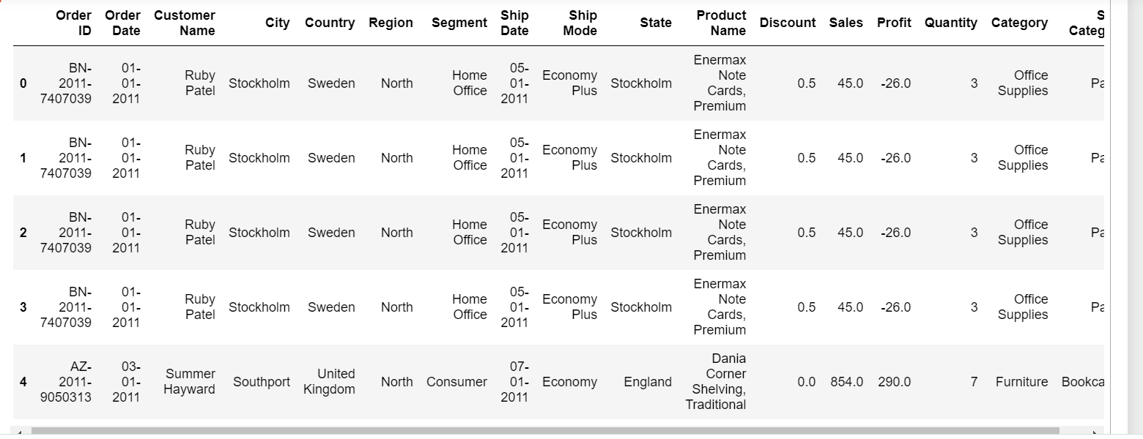
The Dataset after merging:

Slide 9


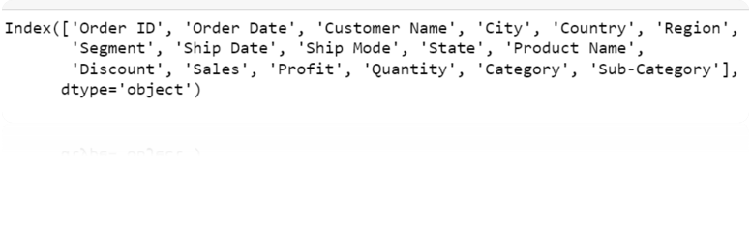
NO OF ATTRIBUTES :
ATTRIBUTES IN DATASET:

Slide 10
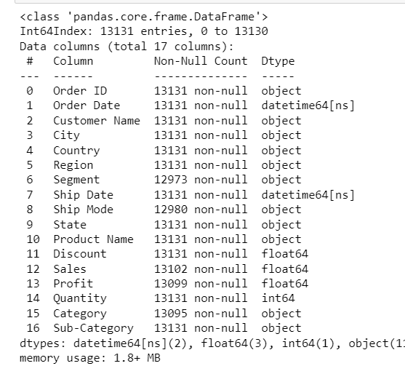
Data Information:

Slide 11
Numerical columns:
Categorical columns:

Slide 12
Independent variable:
Dependent variable:

Slide 13
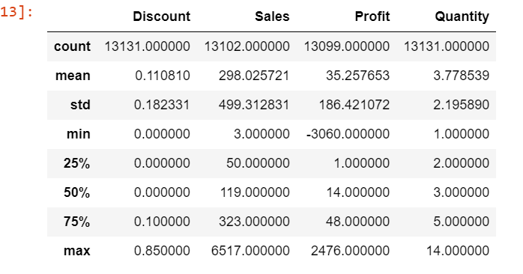
Description of numerical columns:

Slide 14
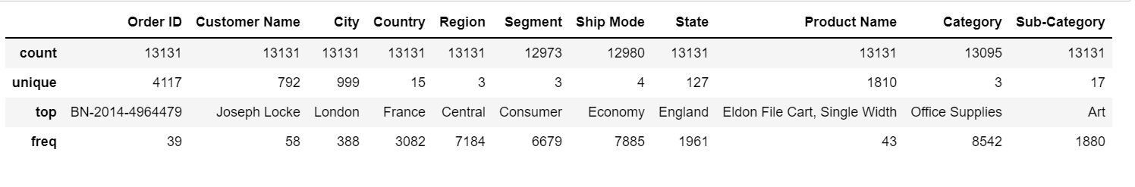
Description of categorical columns:

Slide 15

TO PREDICT PROFIT :​
NO.OF ATTRIBUTES : 5
KIND OF ATTRIBUTES :
DEPENDENT ATTRIBUTE : Profit
INDEPENDENT ATTRIBUTE : Sales, Quantity, Category, Sub-Category,Discount
NATURE OF OUTPUT : Numerical
REGRESSION MODEL :Linear Regression, Random forest, Decision Tree, KNN

Slide 16
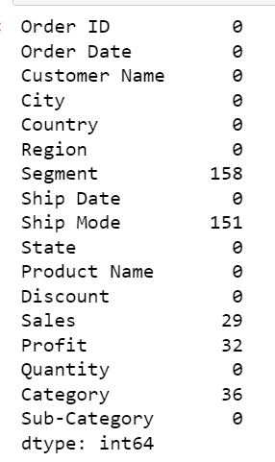
HANDLING NULL VALUES:

Slide 17
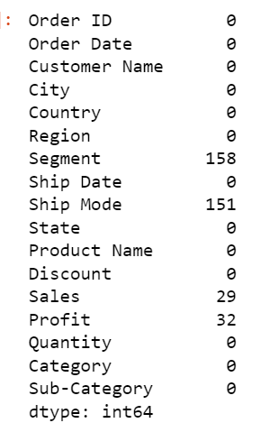
REPLACING NULL VALUES OF CATERGORY

Slide 18
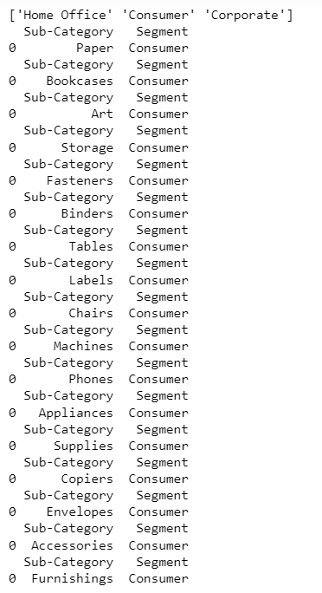
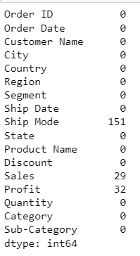
REPLACING NULL VALUES OF SEGMENTS

Slide 19
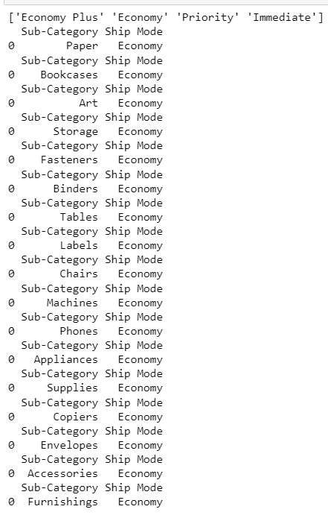
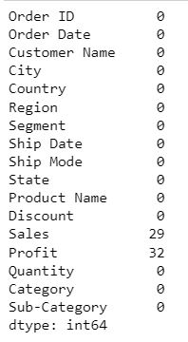
REPLACING NULL VALUES OF SHIP MODE

Slide 20
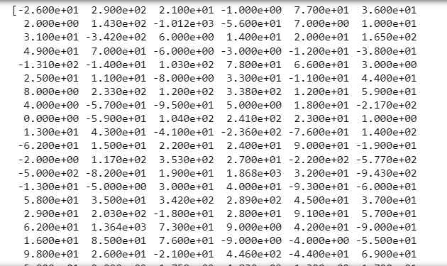
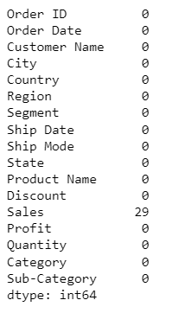
REPLACING NULL VALUES OF PROFIT

Slide 21
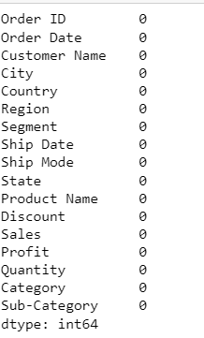
REPLACING NULL VALUES OF SALES

Slide 22
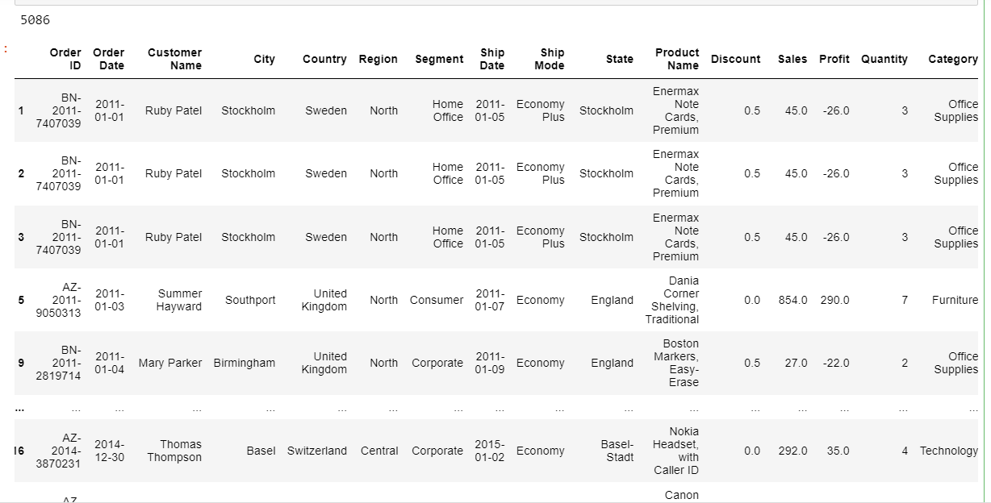
HANDLING DUPLICATE VALUES:

Slide 24


OUTLIERS OF DISCOUNT:
Before:
After:

Slide 25
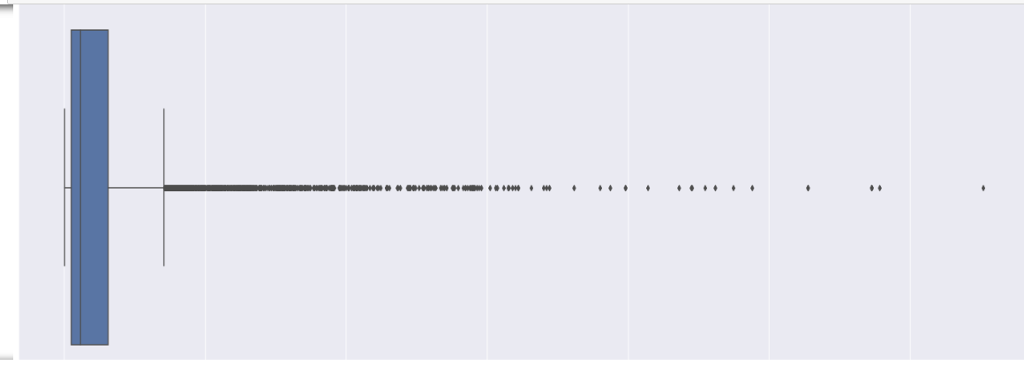

OUTLIERS OF SALES
Before:
After:

Slide 26
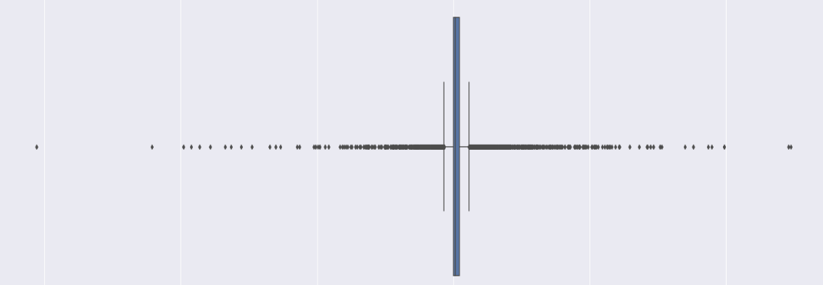
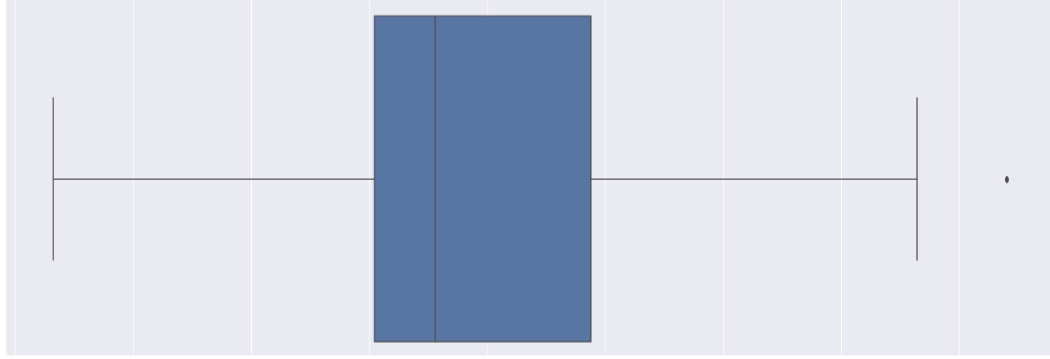
OUTLIERS OF PROFIT:
Before:
After:

Slide 27

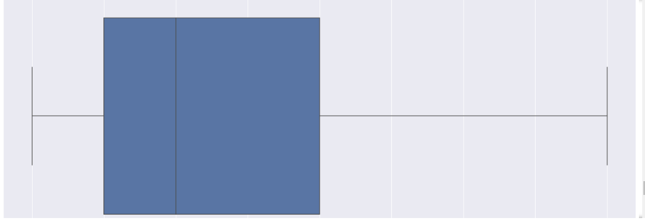
OUTLIERS OF QUANTITY
Before:
After:

Slide 28
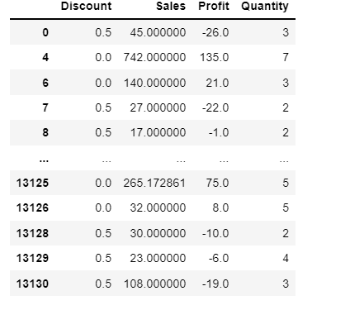
Normalizing the values:

Slide 29
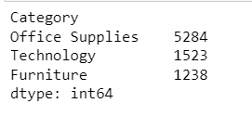
EDA:
SALES PERCENTAGE FOR 3 DIFFERENT CATEGORIES

Slide 30
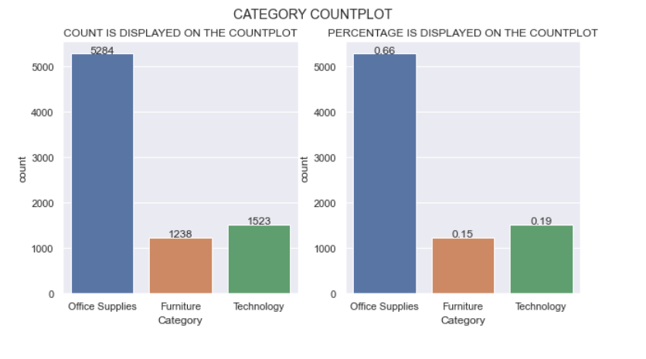
INFERENCE:
Office supplies (0.65) > technology(0.19) >furniture(0.16) .Therefore Office supplies have sold more than furniture and technology.

Slide 31
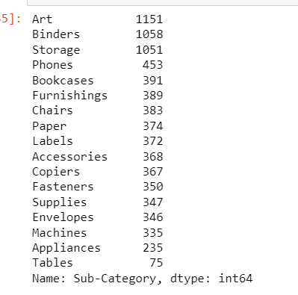
SALES PERCENTAGE FOR DIFFERENT SUB CATEGORIES

Slide 32
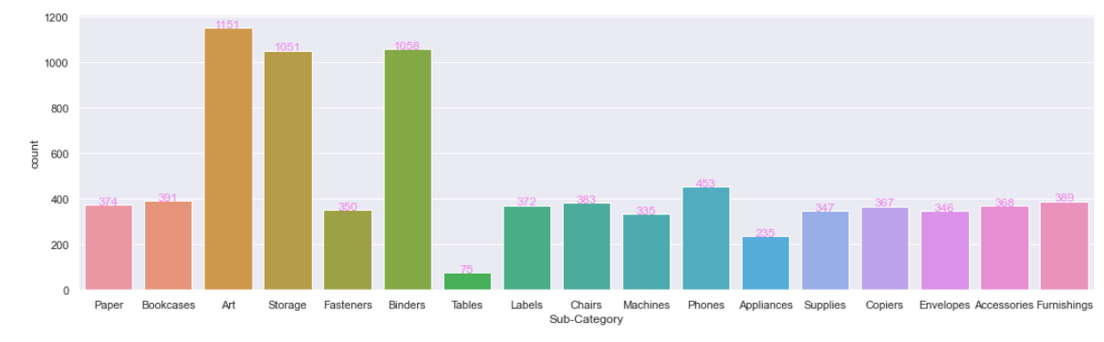
INFERENCE:
Art sub-category has higher sales and Tables sub-category has lower sales

Slide 33
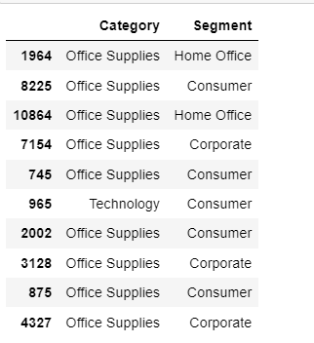
SALES PERCENTAGE FOR 3 DIFFERENT CATEGORIES ACCORDING TO THE SEGMENT OF CUSTOMERS

Slide 34
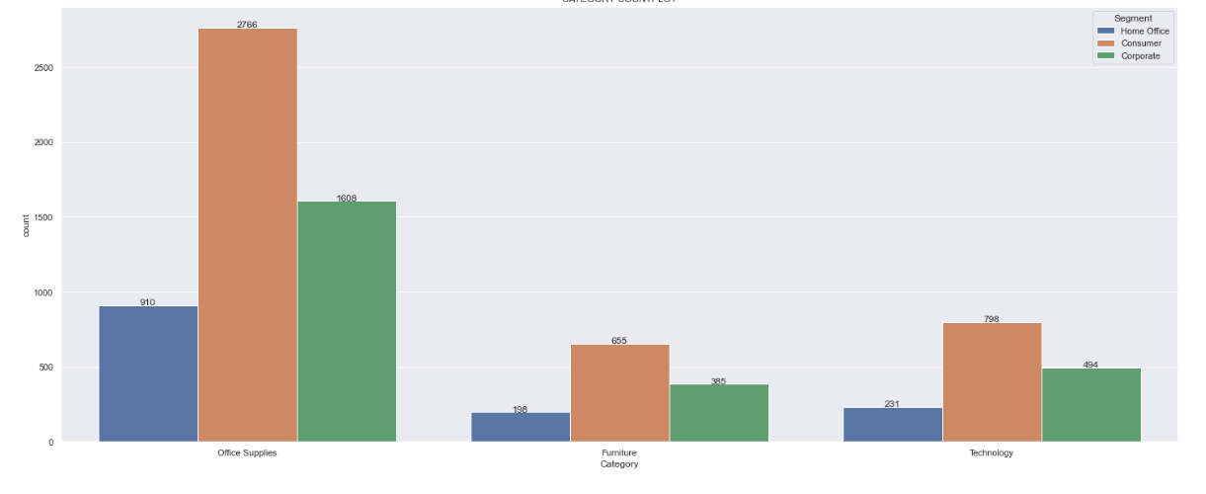
INFERENCE:
Consumer segment have purchased more products than others in all category and Home office segment have purchased less products than others in all category.

Slide 35
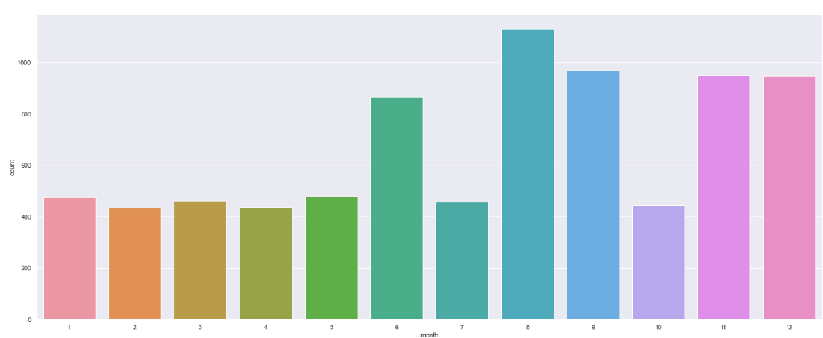
MONTHLY AVERAGE PROFIT FOR ALL YEARS
INFERENCES: In the month of August,sales was higher and the second is September and in February the sale is down.

Slide 36
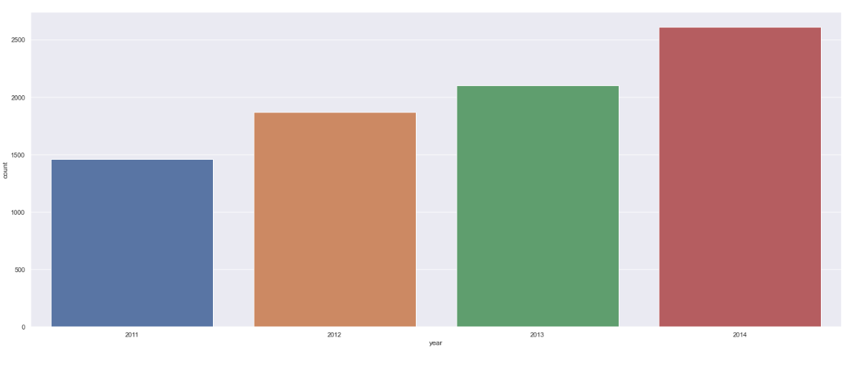
YEARWISE PROFIT
INFERENCES: As the year passes, sales is gradually increasing.

Slide 37
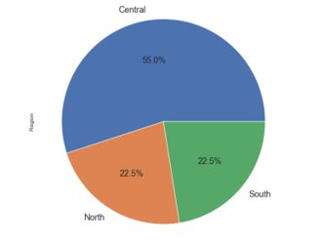

SALES OF PRODUCTS FOR DIFFERENT REGIONS
INFERENCES: Many people from Central region have purchased more products than other regions and South and North region people have purchased only less products.

Slide 38
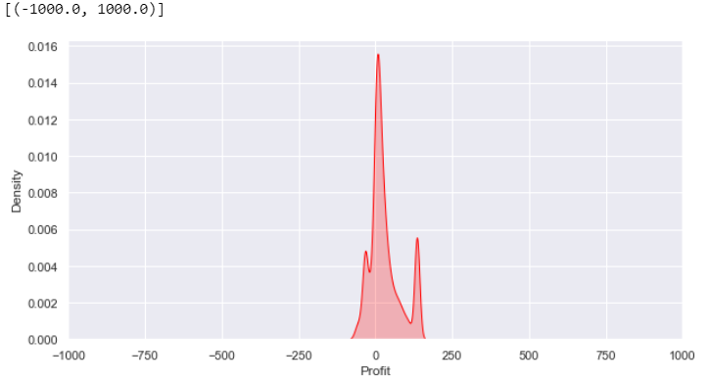
DISTRIBUTION OF PROFIT
INFERENCES: Distribution of profit is very much higher than distribution of loss.

Slide 39
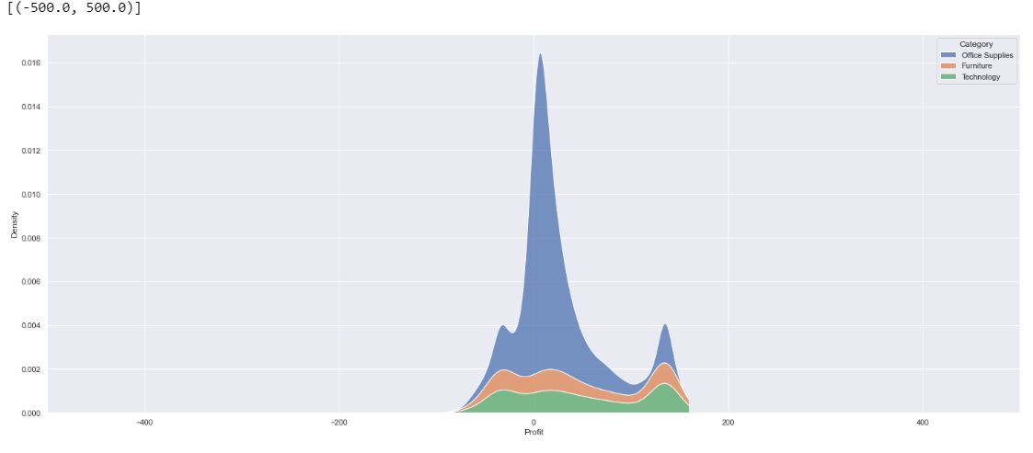
PROFIT DISTRIBUTION DEPENDING ON CATEGORY
INFERENCES: Probability density for profit and categorized by category attribute. From the above, we can see that office supplies has the highest profit.

Slide 40
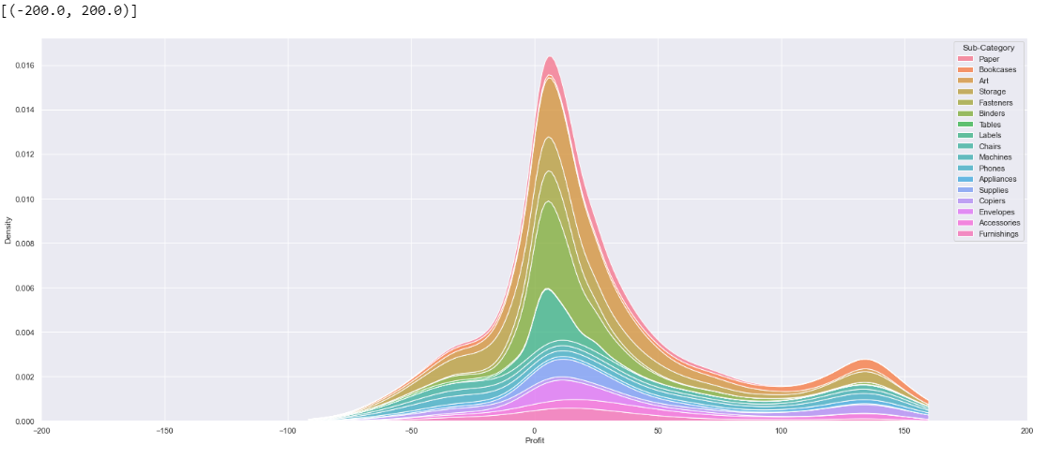
PROFIT DISTRIBUTION DEPENDING ON SUB-CATEGORY
INFERENCES: Probability density of profit categorized by sub-category attribute where labels sub category has the highest profit.

Slide 41
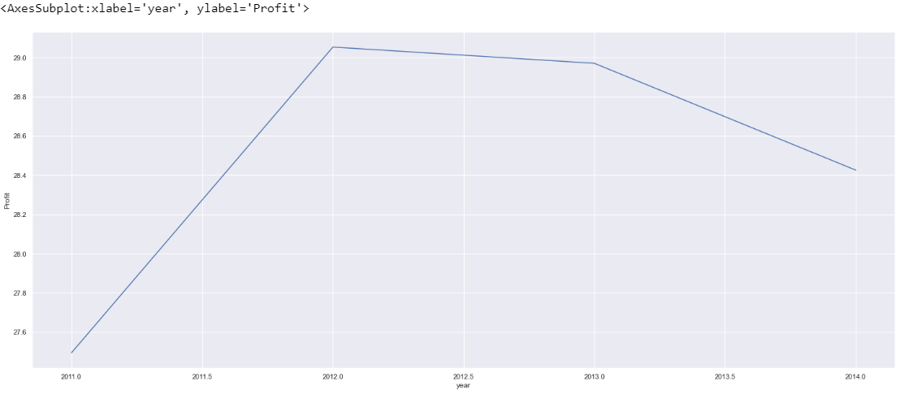
DISTRIBUTION OF PROFIT YEARWISE
INFERENCE: The profit is highest for the year 2012 and it is lowest for the year 2011.

Slide 42
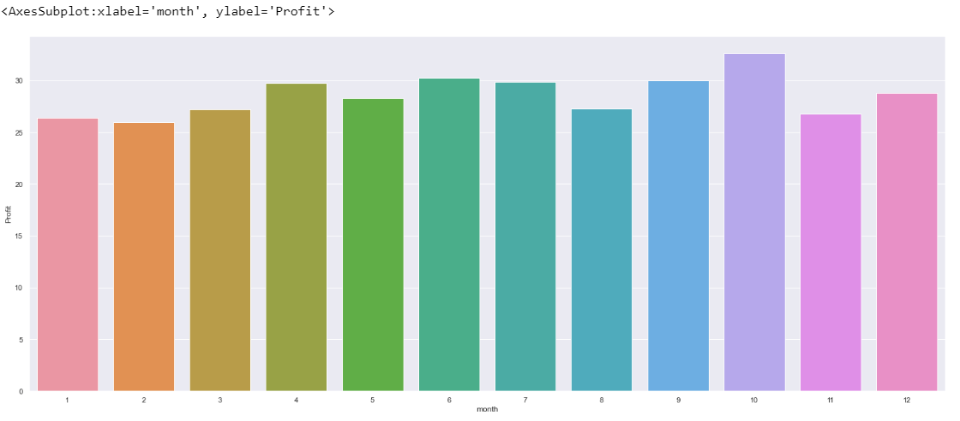
DISTRIBUTION OF PROFIT MONTH WISE
INFERENCE: The profit is higher at the month of October and lowest at the month of February.

Slide 43
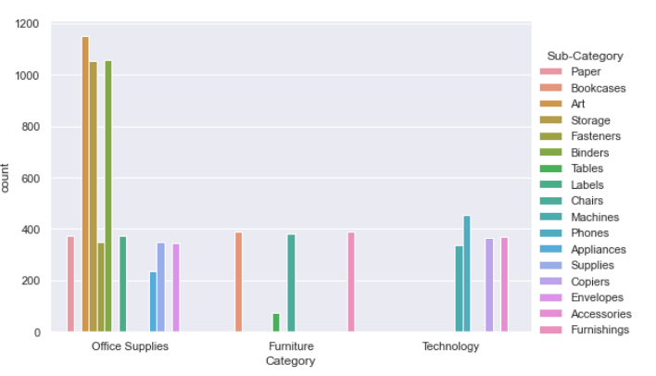
SALES OF CATEGORY DEPENDING ON SUB- CATEGORY
INFERENCE : Sub Categories of Office supplies are purchased more and Sub Categories of Furniture and Technology are purchased in lower rate

Slide 44
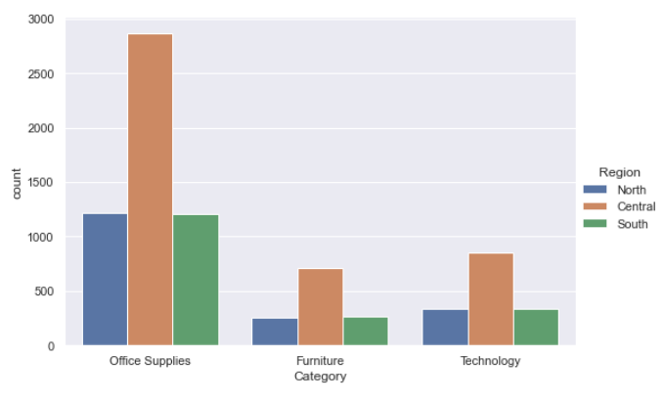
SALES OF CATEGORY DEPENDING ON REGION
INFERENCE: Office supplies are purchased more than furniture and technology category. Central region has more sales in all categories.

Slide 45
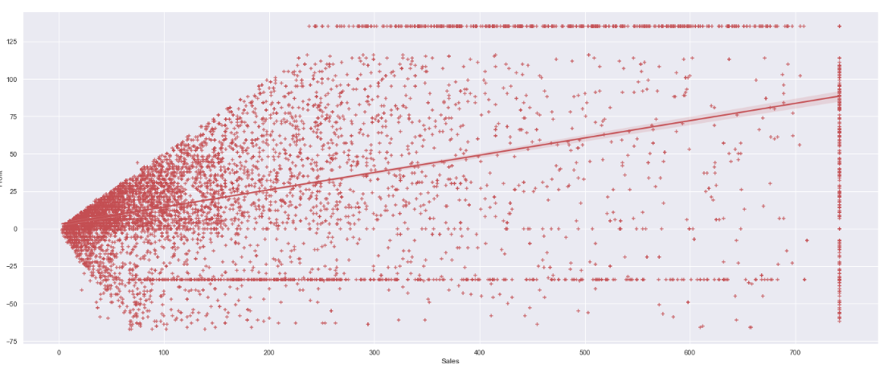
REGRESSION PLOT FOR SALES AND PROFIT
INFERENCES: The best fit line for the attributes sales and profit.

Slide 46
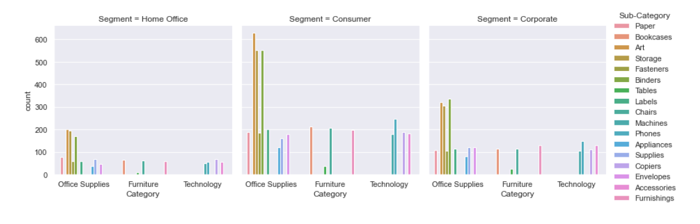
SALES OF DIFFERENT CATEGORIES AND SEGMENTS DEPENDING ON SUB-CATEGORY
INFERENCE: Consumer segment has purchased more in all categories than the other segments. In each segment, Office Supplies are purchsed by many customers

Slide 47
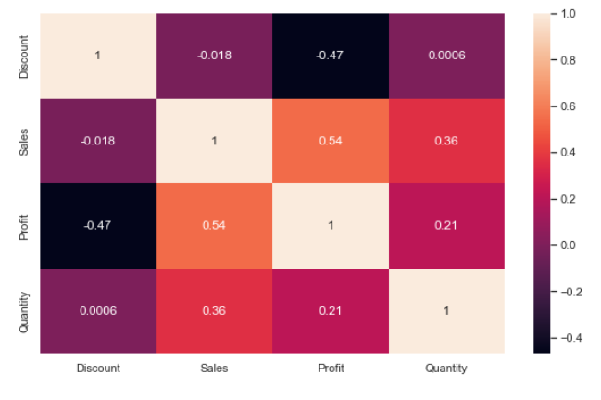
CORRELATION MATRIX
INFERENCES: It shows the correlation between each and every numerical attribute of the dataset. Profit and sales have the second highest correlation.

Slide 48
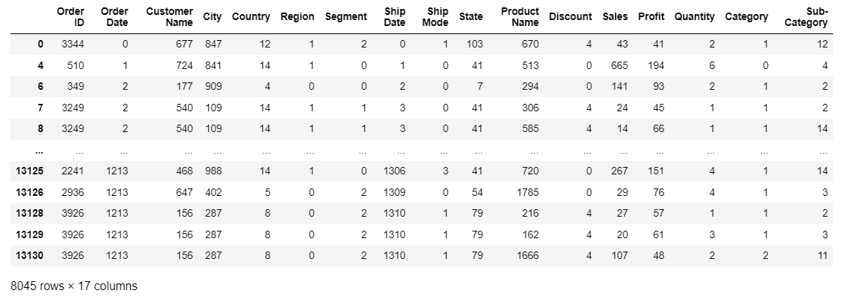
ENCODING OF CATEGORICAL VARIABLES

Slide 49
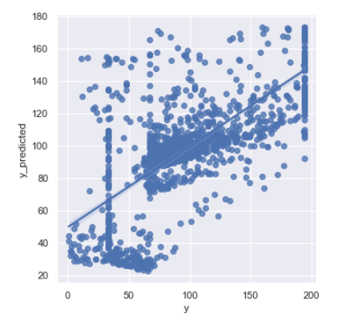
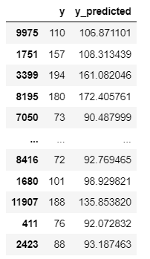
LINEAR REGRESSION WITHOUT PCA AND BAGGING

Slide 50
LINEAR REGRESSION WITH PCA AND BAGGING
HYPERPARAMETER TUNING

Slide 51
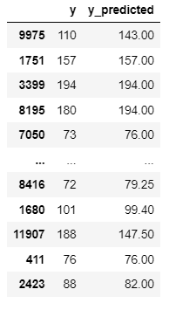
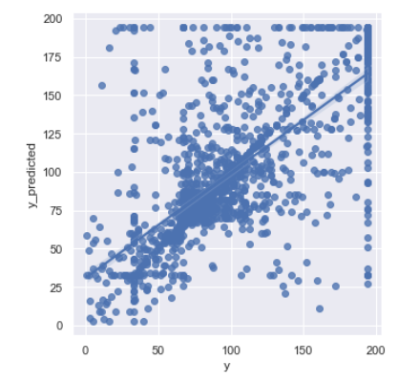
DECISION TREE WITHOUT PCA AND BAGGING

Slide 52
DECISION TREE WITH PCA AND BAGGING
HYPERPARAMETER TUNING

Slide 53
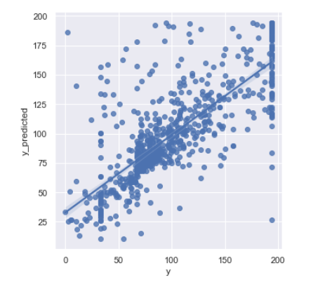
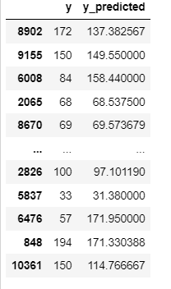
RANDOM FOREST WITHOUT PCA AND BAGGING

Slide 54

RANDOM FOREST WITH PCA AND WITHOUT BAGGING
HYPERPARAMETER TUNING

Slide 55
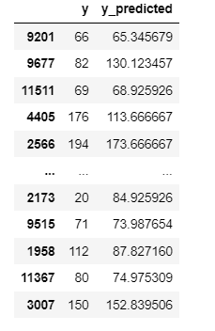
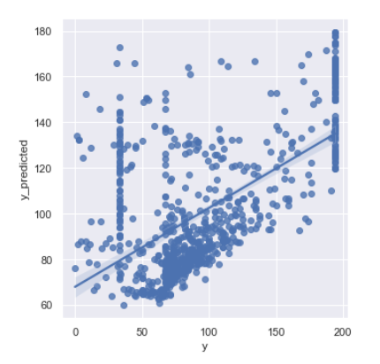
KNN WITHOUT PCA AND BAGGING​

Slide 56

KNN WITH PCA AND BAGGING
HYPERPARAMETER TUNING

Slide 57

ACCURACY OF EACH ALGORITHM

Slide 58

ACCURACY OF EACH ALGORITHM

Slide 59
BOOSTING
ADABOOST
GRADIENT BOOSTING REGRESSOR

Slide 60


BOOSTING ACCURACY

Slide 61

THANK YOU!!..

